Slide 1
ECE 471/571 – Lecture 6
More on Gaussian
- Parametric Estimation
09/08/14

Slide 2
Different Approaches - More Detail
Pattern Classification
Statistical Approach
Syntactic Approach
Supervised
Unsupervised
Basic concepts:
Baysian decision rule
(MPP, LR, Discri.)
Basic concepts:
Distance
Agglomerative method
Parametric learning (ML, BL)
k-means
Non-Parametric learning (kNN)
Winner-take-all
NN (Perceptron, BP)
Kohonen maps
Dimensionality Reduction
Fisher’s linear discriminant
K-L transform (PCA)
Performance Evaluation
ROC curve
TP, TN, FN, FP
Stochastic Methods
local optimization (GD)
global optimization (SA, GA)
ECE471/571, Hairong Qi

Slide 3
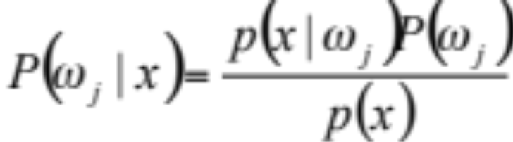
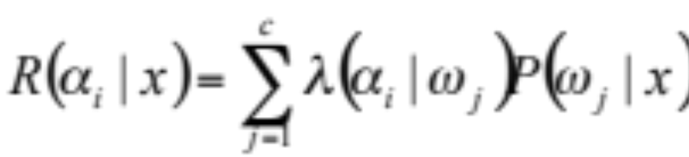
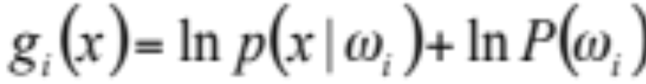
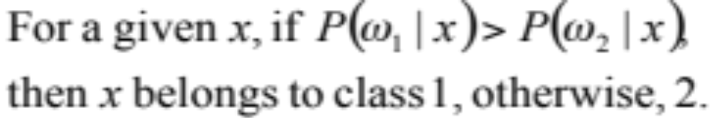
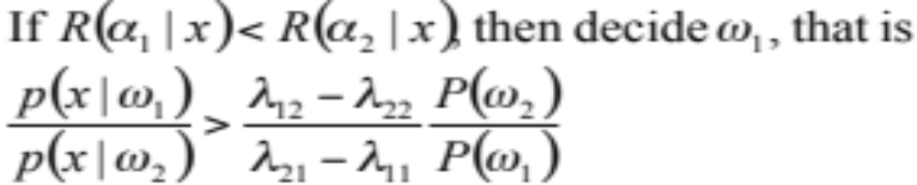
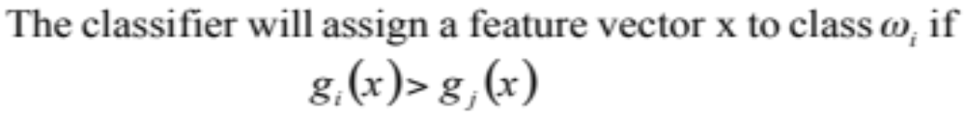
Bayes Decision Rule
Maximum
Posterior
Probability
Likelihood
Ratio
Discriminant
Function

Slide 4
Q&A
Probability density function (PDF) vs.
Cumulative distribution function (CDF)

Slide 5
Central Limit Theorem
Random variables
The pdf of a sum of two random variables is the convolution of their individual pdf’s
The shape of the convolution over many independent random variable pdf’s approaches a limiting shape called the Gaussian shape.

Slide 6
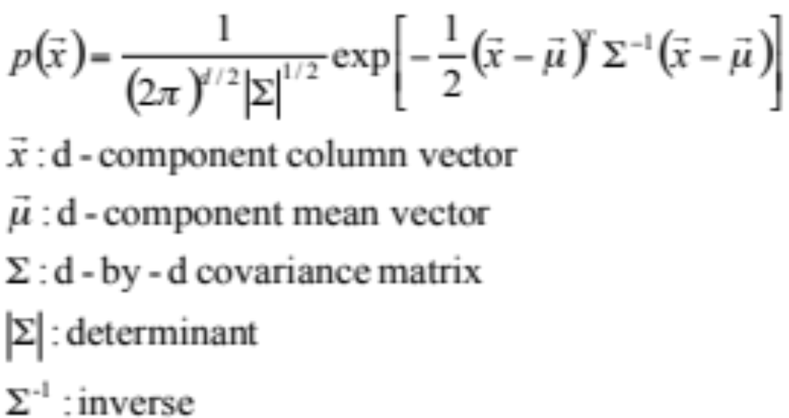
Multivariate Normal Density

Slide 7
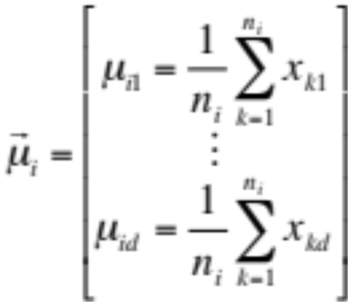
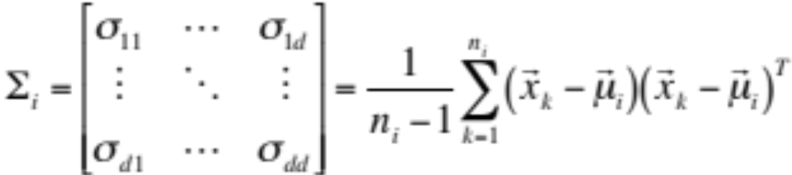
Estimating Normal Densities
Calculate μ, Σ

Slide 8
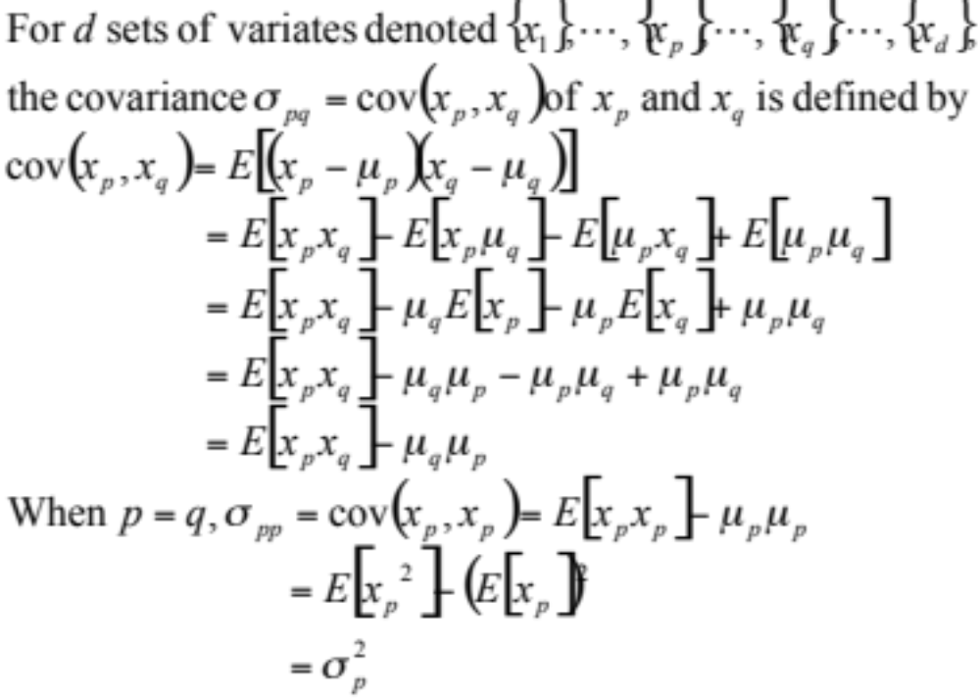
Covariance

Slide 9
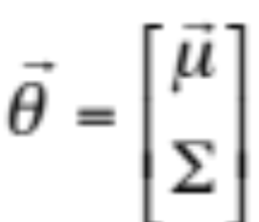
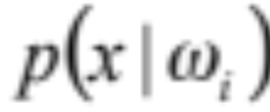
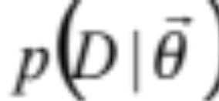
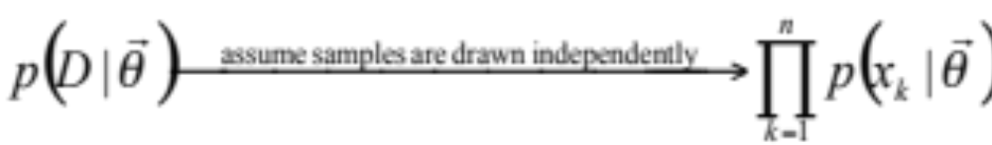
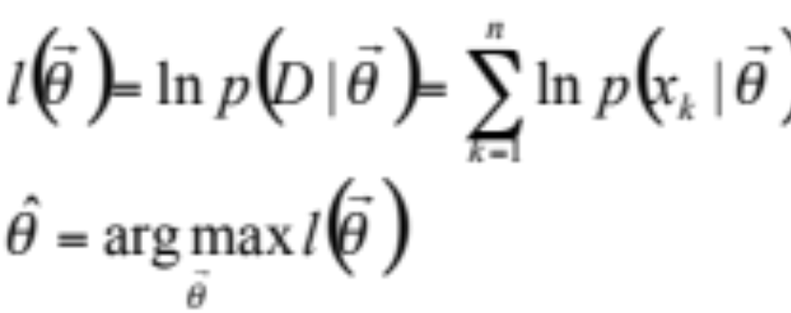
*Why? – Maximum Likelihood Estimation
Compare “likelihood”

Slide 10
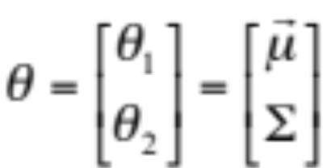
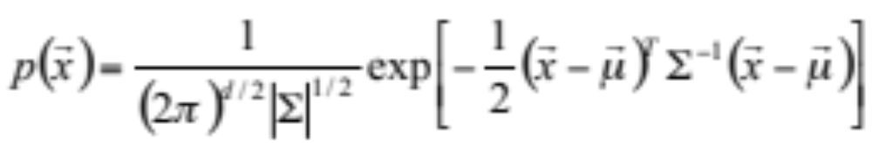
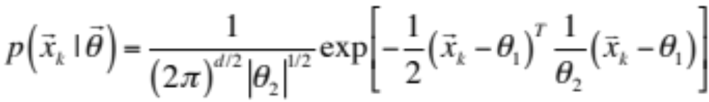
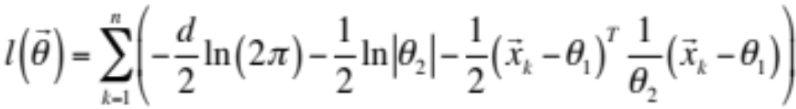
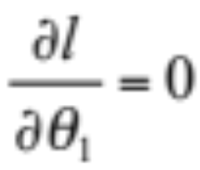
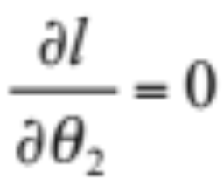
*Derivation

Slide 11
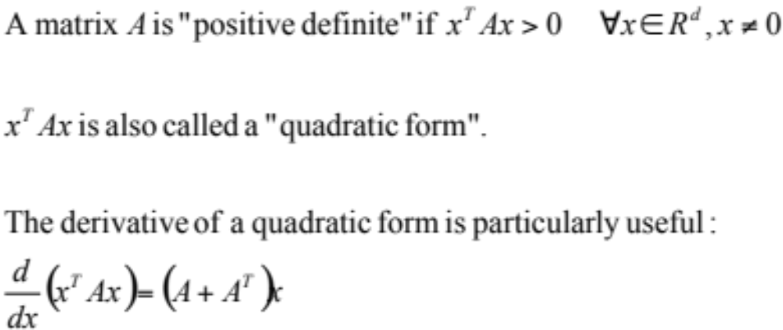
* Derivative of a Quadratic Form

Slide 12

**Why? – Baysian Estimation
Maximum likelihood estimation
  The parameters are fixed
  Find value for θ that best agrees with or supports the actually observed training samples – likelihood of θ w.r.t. the set of samples
Baysian estimation
  Treat parameters as random variable themselves

Slide 13
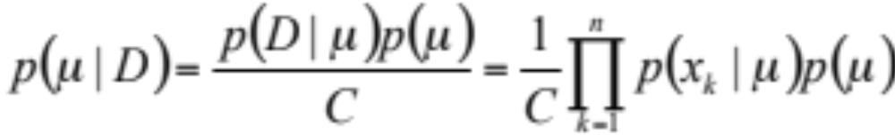
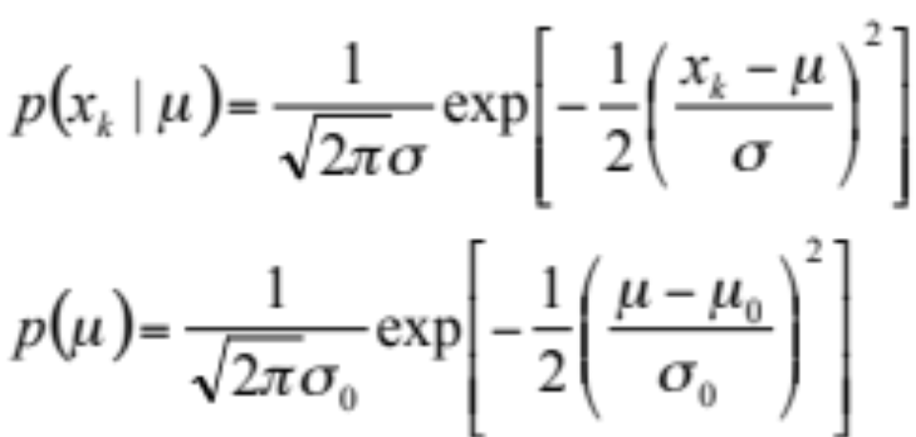
** The pdf of the parameter (μ) is Gaussian

Slide 14
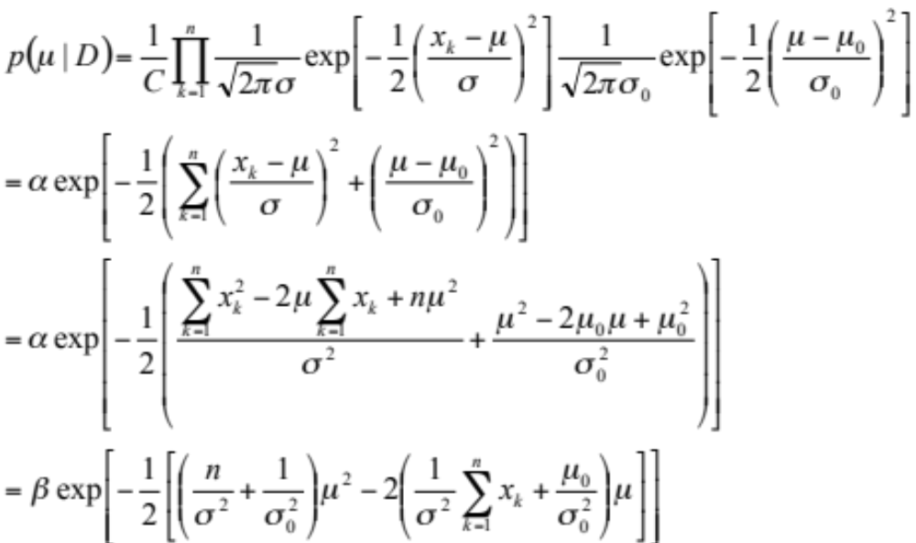
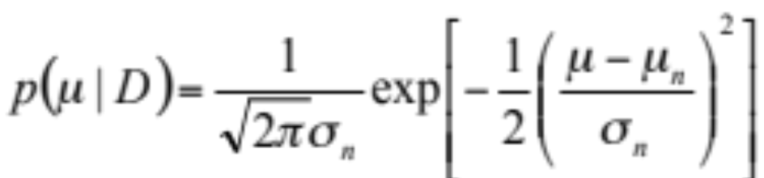
** Derivation

Slide 15
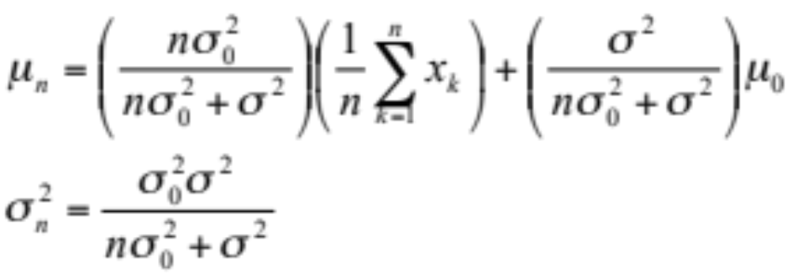
∗∗ μ_{n} and σ_{n}
Our best guess for μ after observing n samples
Measures our uncertainty about this guess
Behavior of Bayesian learning
  The larger the n, the smaller the σ_{n} – each additional observation decreases our uncertainty about the true value of μ
  As n approaches infinity, p(μ|D) becomes more and more sharply peaked, approaching a Dirac delta function.
  μ_{n} is a linear combination between the sample mean and μ₀

